Slide 1
2025 CALENDAR OF ACTIVITIES
1. SEASON OF PRAYER AND FASTING 2025 - January 1-17, 6AM, 12NN, 7PM More emphasis on 'FASTING'
January 18, Saturday - Culmination at WOH Paradise - 8AM-12NN
2. LAUNCHING OF HLC LEADERSHIP TRACT (For all Ministry Heads and Key Leaders)
To be equipped more of God's Word
December 16-Start of Registration
3. BIBLELYMPICS 2025 - January 25, Saturday
Simultaneous with Central & Satellites, with Registration of P1,000 - NKJV Version

Slide 2
3. GRAND FINALS - February 1, Saturday BIBLELYMPICS (Intersatellite)
4. February 22, Saturday – UNCENSORED 2025 (LOVE SUMMIT)
5. March 15, Saturday - Women's Conference / DVBS Training
6. March 29, Saturday - Mission Emphasis

Slide 3
7. April 5, Saturday - CONTINUATION of Mission Emphasis - DVBS Training
8. April 16-18 Holy Week - April 18, GOOD FRIDAY with all Satellites
9. April 20, Sunday - Easter Cantata
10. 3 Days DVBS at WOH Central & Satellites
11. May 11, Sunday - Mothers' Day
12. May 12, Monday - Election Day
13. May 19, Monday - Pastoral Staff Outing
14. May 26-30, Mon-Fri, Brigada Iglesia (Adopt a classroom)
15. June 12, Thursday - Family Fun Day with Water Baptism at WOH Paradise - 8AM-12NN
16. June 15, Sunday – Father’s Day
17. June 28, Saturday – MEN’S CAMP 2025

Slide 4
18. July 13 & 20, Saturdays - Ministry Emphasis – PICTURE BOOTH
19. August 1, FRIDAY, Kick-off/Parade
20. August 20-21-22- Pastors Conference
21. August 23, Saturday - Workers Breakfast
22. August 24, Sunday - WOH37th Grand Anniversary
23. August 30, Saturday - YA Clan
24. September – SPEAK LIFE Discipleship Summit 2025

Slide 5
25. October? - October Praise / Music Symposium
26. October 26, Sunday - Pastors Appreciation Sunday
27. November 15, Saturday - Life Group Celebration with Registration Fee P150.00
28. November 25, Tuesday – Pastoral Planning
29. December 7, Sunday - Kids Cantata
30. December 13, Saturday - Workers Christmas Party
31. December 16-24 - Christmas Revival @ 7PM WOH Central
32. December 21, Sunday - Adult Cantata
33. December 25, Thursday, 5PM - Candlelight Service with all Satellites
34. December 31, Wednesday, 5PM - Communion Service

Slide 6
PARADISE
GROUP 1 GROUP 2 GROUP 3
(Jan.-Apr.) (May-Aug.) (Sept.-Dec.)
Bro. Jomik 1. Sis. Lorie 1. Bro. Jerric
Sis. Jho 2. Sis. Camille 2. Sis. Bhing
Bro. Fernan 3. Sis. Flor 3. Sis. MJ
Sis. Rachelle 4. Sis. Elly 4. Sis. Elsa
Bro. Michael 5. Sis. Joy 5. Bro. Dwayne
Sis. Michelle 6. Bro. Patrick 6. Bro. JoJo
Sis. Nida 7. Sis. Lorina 7. Sis. Leriza

Slide 7
MUZON
GROUP 1 GROUP 2 GROUP 3
(Jan.-Apr.) (May-Aug.) (Sept.-Dec.)
Bro. Marlon 1. Sis. Jessa 1. Sis. Rudy Ann
Sis. Renalyn 2. Sis. Jhinky 2. Sis. Anne
Sis. Fe 3. Sis. Emmalyn 3. Sis. Salome
Bro. Rommel 4. Sis. Janice 4. Sis. Mia
Sis. Noemi 5. Sis. Gemm a 5. Sis. Riza
Bro. Roden 6. Bro. Jess

Slide 8
TUNGKO
GROUP 1 GROUP 2 GROUP 3
(Jan.-Apr.) (May-Aug.) (Sept.-Dec.)
Bro. Robert 1. Sis. Daphne 1. Sis. Jo
Sis. Ricky 2. Bro. Reynold 2. Sis. Florie
Sis. Mylene 3. Sis. Nita 3. Sis. Racel
Sis. Geraldine 4. Bro. Aldrin 4. Sis. Liezel
Bro. Andrei 5. Sis. Leony 5. Sis. Jhanie
Sis. Aubre 6. Bro. Alvin 6. Bro. Dong

Slide 9
TUNGKO
GROUP 1 GROUP 2 GROUP 3
(Jan.-Apr.) (May-Aug.) (Sept.-Dec.)
Bro. Robert 1. Sis. Daphne 1. Sis. Jo
Sis. Ricky 2. Bro. Reynold 2. Sis. Florie
Sis. Mylene 3. Sis. Nita 3. Sis. Racel
Sis. Geraldine 4. Bro. Aldrin 4. Sis. Liezel
Bro. Andrei 5. Sis. Leony 5. Sis. Jhanie
Sis. Aubre 6. Bro. Alvin 6. Bro. Dong

Slide 10
PARADISE-GROUP 1
January 1-17
SOPF M,T,Th,F - Online (7pm)
Wed - Physical (midweek)
January 19 or 26 (Sunday) –
Biblelympics January 31 - Joint fellowship
February 15 - Uncensored Paradise
February 28 - Joint Fellowship
March (Mission Emphasis Month) - Saturdays (1,8,15,22) –
Evangelism and Feeding March 28 –
Joint Fellowship March 29 - Mission emphasis
March 30 - Paradise Anniversary
April – LWEP April 12 or 19 or 26 (Tentative) –
Film showing April 25 - Joint Fellowship
April 27 - Muzon anniversary

Slide 11
PARADISE-GROUP 2

Slide 12
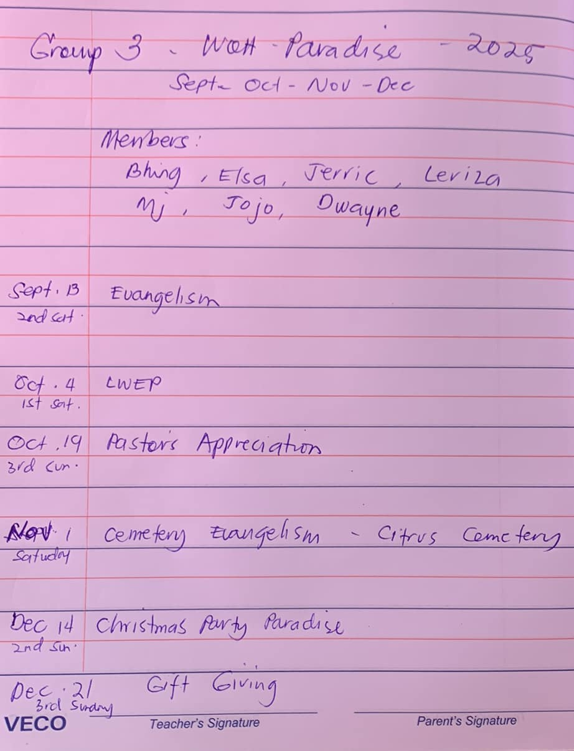
PARADISE
-GROUP 3

Slide 13
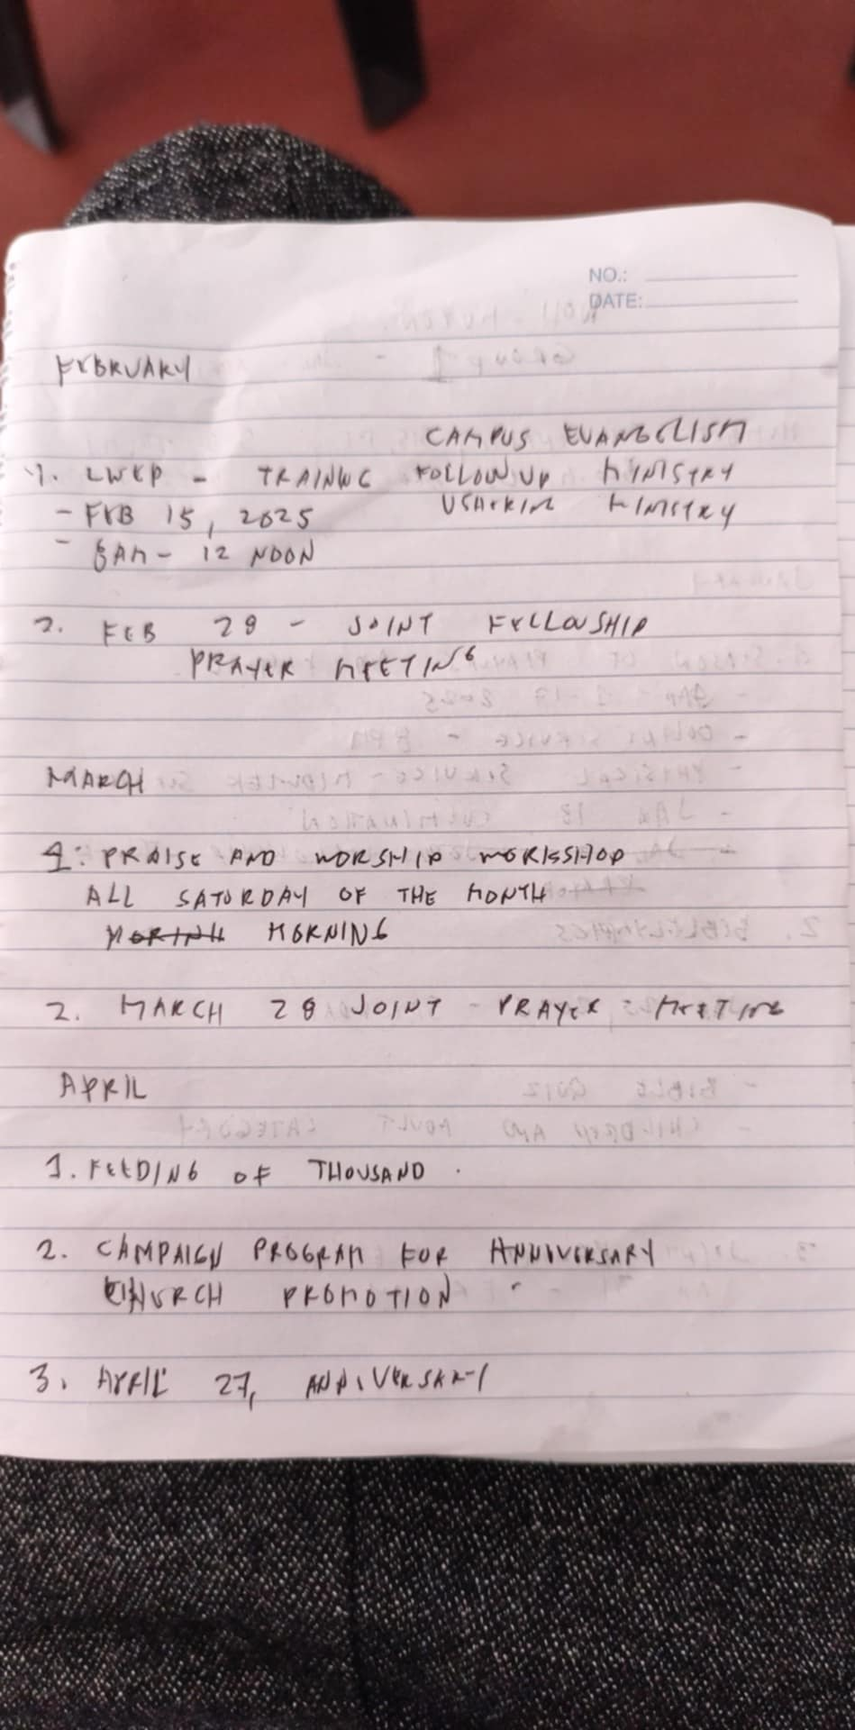
MUZON
-GROUP 1

Slide 14
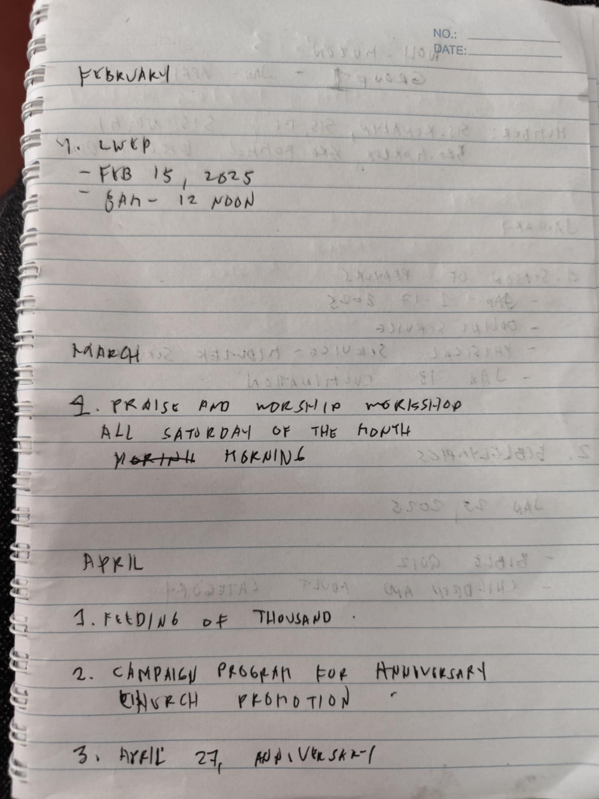
MUZON
-GROUP 1

Slide 15
MUZON-GROUP 2
Member Salome, Ann, Riza, Jess, Rudy Ann, Mia,
May to August 2025
May. May 3 2025 Saturday
Mother's day treat -massage, manicure, pedicure, haircut
May 11 Sunday Mother's day Celebration - Token, video presentation
May 14-17 national women's vonfere6
May 24-Saturday Summer outing/team building Tentative budget 500 each
May 28 29 30 DVBS

Slide 16
MUZON-GROUP 2
June June 7
Saturday Joint fellowship mens and womens -women's treat to all fathers
June 15 Sunday Father's day celebration - to give token of appreciation July Worship night –
During midweek-1st or 2nd week of
july
July 26 - LWEP
AUGUST WORD of Hope central anniversary month-

Slide 17
MUZON-GROUP 3

Slide 18
TUNGKO-GROUP 1
Create GC for the group - Geraldine •
Season of Prayer and fasting
(January 1-2 & 6-9 & 13-16 online service prayer Time 8pm
•3, 10, 17 Friday (Physical Service) of prayer and fasting
•Biblelympics- per Ministry magcoconduct kami ng games about bible January 25 Sunday afternoon at 3pm
•Love Series February 15, 2025 (Love Courtship & Marriage) (Seminar about love, Family)
•DVBS March 26, 27,28 Hindi pa sure if Wala ng pasok ang mga Bata sa school
•Mission Emphasis - Feeding Program & Evangelism March 29, 2025 Saturday, Morning Outside church
•LWEP- Saturday -April1 2, 2025
•Holy Week - Film showing / Station of the cross - Pakwanan (April 19, 2025 7 houses - Joint Prayer Meeting - Every last Friday of the month

Slide 19
TUNGKO-GROUP 2
May
11 - Mother's Day - 50 mothers
30 - Joint Prayer Meeting
31 - Family Fun Day / Sports Fest - 100 pax
June
15 - Father's Day - 50 men
27 – Joint Prayer Meeting
28 - Brigada Eskwela
July
13 & 20 - Training / Workshop (Music, Media, etc.)
19 – LWEP
25 - Joint Prayer
August
2 - English 101 - 50 pax youth and young professionals
29 - Joint Prayer Meeting

Slide 20
TUNGKO-GROUP 3
Members: florie, racel, liezel, jhanie, Dong, jojo
September –Anniv Month Theme: Same as central
Feeding of thousands 6,13, 20,
27 Joint prayer meeting:
Sept 26 Grand celeb: Sept 28
8-11 1st service 1-4pm 2nd service Venue: Church Invite Guest speaker Event sa main: Speak Life
October LWEP - 1st sat:
Oct 4 - Evaluation Anniv
Pastor's Appreciation -Oct 26
November
Cemetery evangelism Nov 1. Providence Cemetery in Gaya Gaya
Nov 15 - LG celeb - Central
December
Christmas revival nights 17, 19 23 - Culmination Christmas celeb central
Dec 13 Celeb of Tungko 14
Gift giving Dec. 21

